Slide 1
Linq (Language Integrated Query) in C#

Slide 2
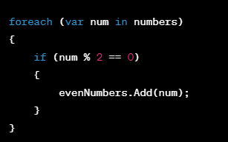
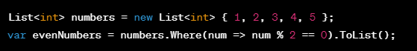
Advantages of using linq queries over traditional query
Readability and Conciseness:
LINQ queries are more readable and concise, making the code easier to understand.

Slide 3
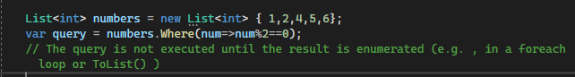
Integration with language features:
LINQ is integrated into the c# language , allowing you to use it seamlessly with other language features like lambda expressions.
Type safety:
LINQ queries are strongly typed, which means that the compiler can catch errors at compile-time rather than runtime.
Querying different data sources:
LINQ is designed to work with various data sources,including databases, in memory collections,XML and more.
The same LINQ syntax can be used across different data types.
Deferred Execution:
LINQ queries use deferred execution, meaning that the query is not executed until the result is actually needed.

Slide 4
Types of syntax used for LINQ queries
Query Syntax:
This syntax resembles SQL statements, making it intuitive for those familiar with databases.
It uses keywords like from, where, select, orderby, etc., similar to SQL clauses.
Offers a declarative approach, focusing on what you want to achieve rather than how.
Method Syntax:
This syntax leverages extension methods provided by LINQ libraries.
It chains method calls like Where, Select, OrderBy, etc., offering a functional style.
Can be combined with lambda expressions for concise filtering and transformations.

Slide 5
LINQ: Standard Query Operators
Where: Filters elements based on a specified condition.
Select: Transforms elements into a new form.
OrderBy / OrderByDescending: Sorts elements in ascending or descending order.
GroupBy: Groups elements based on a specified key.
Join: Combines two collections based on a common key.

Slide 6
Standard query operators
Where:
Filters elements based on a specified condition.
Can accept anonymous functions (lambda expressions) or expressions defined separately for complex conditions.
Can be chained with multiple Where clauses for more granular filtering.

Slide 7
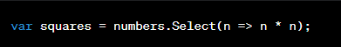
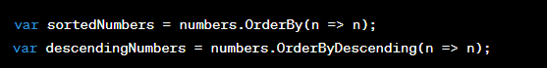
Cont…
Select:
Projects each element of a sequence into a new form
OrderBy / OrderByDescending:
Sorts elements in ascending or descending order.

Slide 8
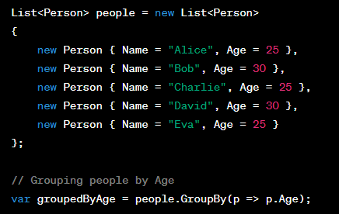
Cont…
Group by:
The GroupBy operator in LINQ is used to group elements of a sequence based on a key. It returns a sequence of IGrouping<TKey, TElement> where each group has a key and a collection of elements that share that key.

Slide 9
Aggregate functions in LINQ
Sum()
Average()
Min()
Max()
Count()
Aggregate():
The Aggregate function is a more flexible method that allows you to perform custom aggregation operations. It takes a lambda expression with two parameters - the accumulated result and the current element.

Slide 10
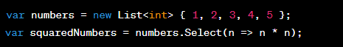
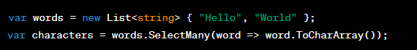
Projection operators in LINQ
Select:
The Select operator is used to transform each element in a sequence.
SelectMany:
The SelectMany operator is used to flatten a sequence of sequences or perform a one-to-many projection.

Slide 11
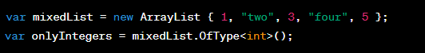
Cont…
OfType:
The OfType operator filters the elements of a sequence based on a specified type.

Slide 12
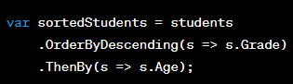
Ordering operators in LINQ
OrderBy()
OrderByDescending()
ThenBy()/ThenByDescending():
The ThenBy operator is used for secondary sorting. It is applied after OrderBy or OrderByDescending to further sort elements.
Reverse():
The Reverse operator reverses the order of elements in a sequence.

Slide 13
Partitioning operators in LINQ
Take:
The Take operator returns a specified number of elements from the beginning of a sequence.
Skip:
The Skip operator bypasses a specified number of elements and returns the remaining elements.
TakeWhile:
The TakeWhile operator returns elements from the beginning of a sequence as long as a specified condition is true.
SkipWhile:
The SkipWhile operator bypasses elements from the beginning of a sequence as long as a specified condition is true and returns the remaining elements.

Slide 14
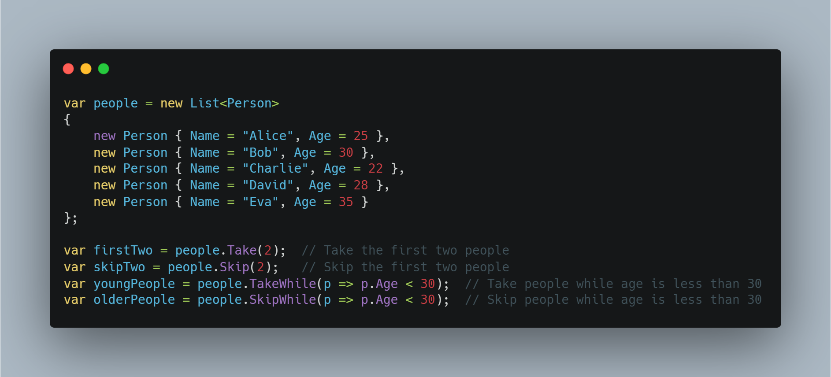
Cont…

Slide 15
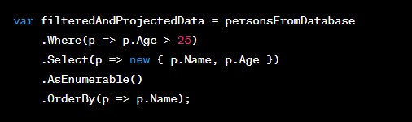
AsEnumerable() in LINQ
The AsEnumerable() method in LINQ is used to force the query to be evaluated on the client side rather than on the database or the source collection. It can be useful in scenarios where you want to perform some client-side operations on the data after fetching it from the database.

Slide 16
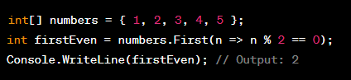
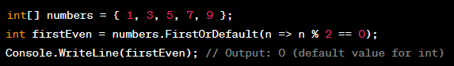
Element operators in LINQ
First Operator:
Returns the first element of a sequence that satisfies a specified condition.
FirstOrDefault Operator:
Returns the first element of a sequence that satisfies a specified condition, or a default value if no such element is found.

Slide 17
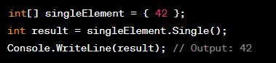
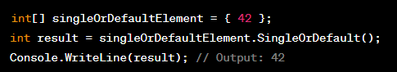
Cont…
Single Operator:
Returns the only element of a sequence that satisfies a specified condition; throws an exception if no or more than one element is found.
SingleOrDefault Operator:
Returns the only element of a sequence that satisfies a specified condition or a default value if no such element is found; throws an exception if more than one element is found.

Slide 18
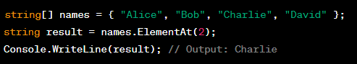
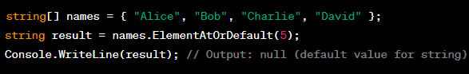
Cont…
ElementAt Operator:
Returns the element at a specified index in a sequence.
ElementAtOrDefault Operator:
Returns the element at a specified index in a sequence or a default value if the index is out of range.

Slide 19
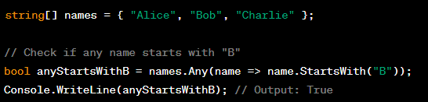
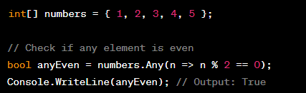
Quantifiers in LINQ
Any Operator:
Determines whether any element in a sequence satisfies a specified condition. It returns a boolean value indicating whether at least one element meets the condition.

Slide 20
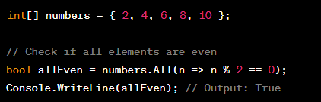
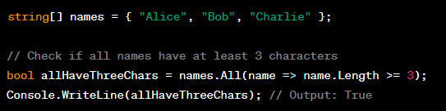
Cont…
All Operator:
Determines whether all elements in a sequence satisfy a specified condition. It returns a boolean value indicating whether every element meets the condition.

Slide 21
Joins in LINQ
In C#, the Join keyword is used in LINQ (Language-Integrated Query) to perform a join operation on two collections or sequences based on a specified key. The Join keyword allows you to combine elements from two different sequences based on a common attribute or key, creating a new sequence that contains elements with matched keys.
There are two ways we can write join LINQ query. Both returns same values.
Examples are as follows

Slide 22
Cont…
Join:
Behavior: Performs an inner join, which means it returns only the elements that have matching keys in both sequences.
Result: Produces a flat result set where each element in the result corresponds to a pair of matching elements from the original sequences.
Example: If there are multiple matches for a key in either sequence, each combination will be included in the result.

Slide 23
Cont…
Query Syntax
var result = from variable1 in collection1
join variable2 in collection2
on variable1.Key equals variable2.Key
select new { variable1, variable2 };

Slide 24
Cont…
Method Syntax
var result = collection1
.Join(collection2,
variable1 => variable1.Key,
variable2 => variable2.Key,
(variable1, variable2) => new { variable1, variable2 });

Slide 25
Cont…
GroupJoin:
Behavior: Performs a group join, which means it groups elements from the left sequence based on their keys and associates each group with matching elements from the right sequence.
Result: Produces a sequence of groups where each group contains a key and a collection of matching elements from the right sequence.
Example: If there are multiple matches for a key in either sequence, all matching elements are grouped together.

Slide 26
Cont…
Query Syntax
var result = from variable1 in collection1
join variable2 in collection2
on variable1.Key equals variable2.Key into temp
from variable2 in temp.DefaultIfEmpty()
select new { variable1, variable2 };

Slide 27
Cont…
Method Syntax
var result = collection1
.GroupJoin(collection2,
variable1 => variable1.Key,
variable2 => variable2.Key,
(variable1, temp) => new { variable1, variable2 = temp.DefaultIfEmpty() })
.SelectMany(x => x.variable2.Select(y => new { x.variable1, y }));

Slide 28
Cont…
Here are other join in LINQ
Left Outer Join:
Retrieves all records from the left (first) table and the matching records from the right (second) table. Non-matching records from the right table will contain null values in the result.
Right Outer Join:
Retrieves all records from the right (second) table and the matching records from the left (first) table. Non-matching records from the left table will contain null values in the result.

